Slide 1

LAWS OF MOTION
Cause of motion
Balanced and Unbalanced forces

Slide 2






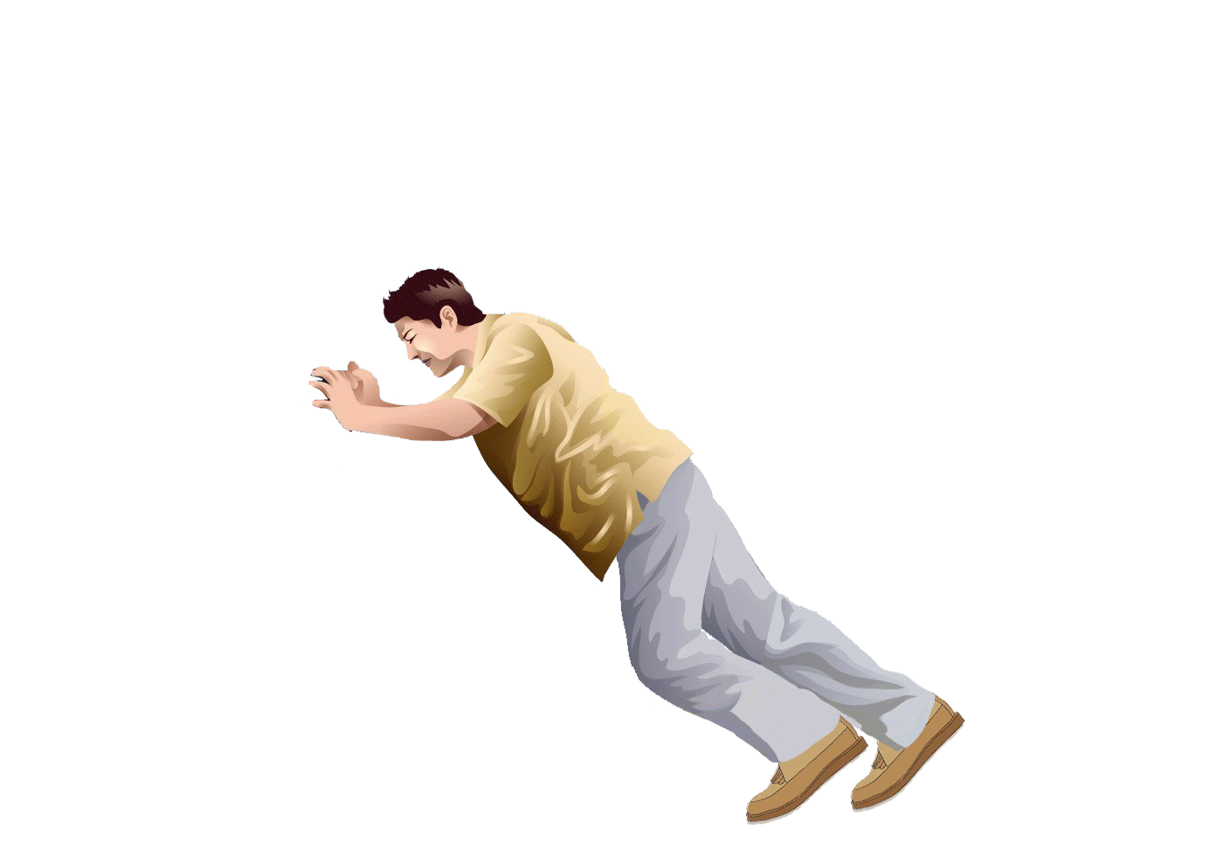

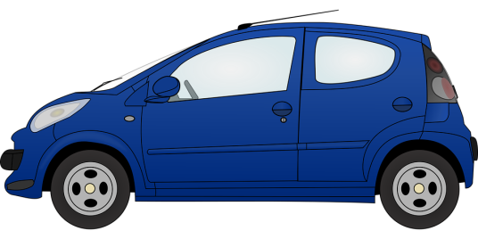
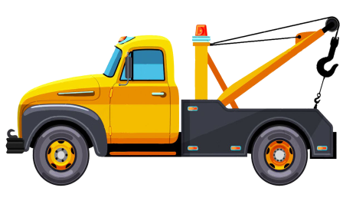
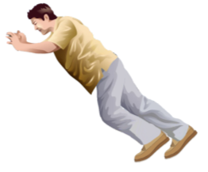




Let us consider few examples
What causes motion ??
Rules
When there is a change in the position of an object with respect to its surrounding it is said to be in motion
Cause of motion is FORCE
Simple push or pull is FORCE!!
In the picture we can see the man pushing the car
We can say that the car is being pulled by the towing van
Force is pull
Force is push

Slide 3

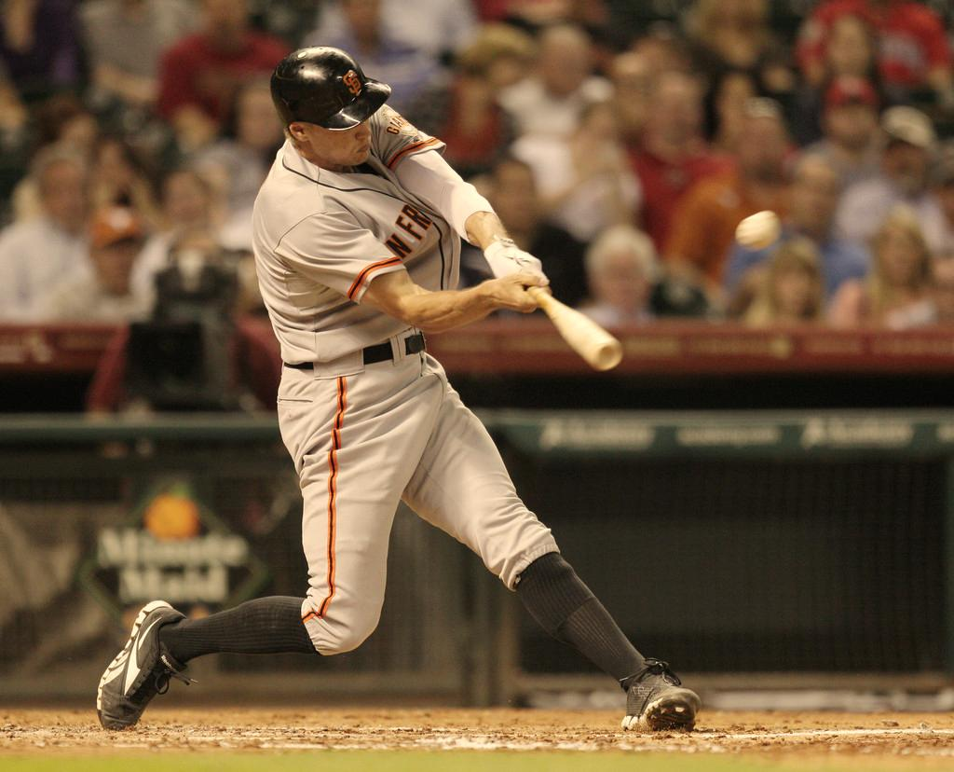
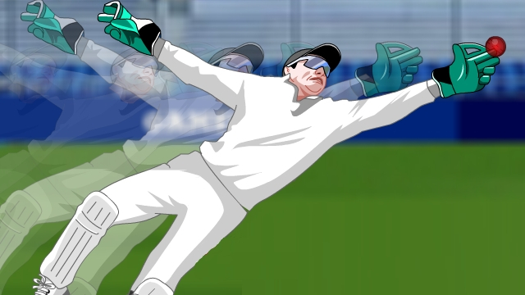
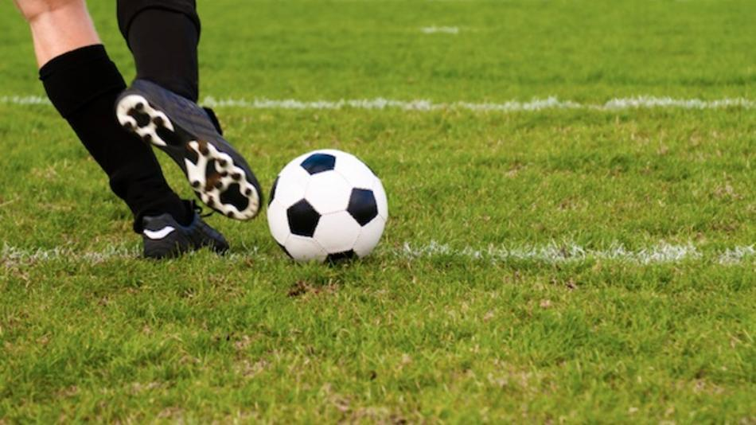
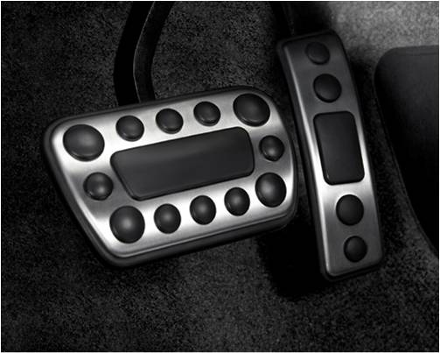
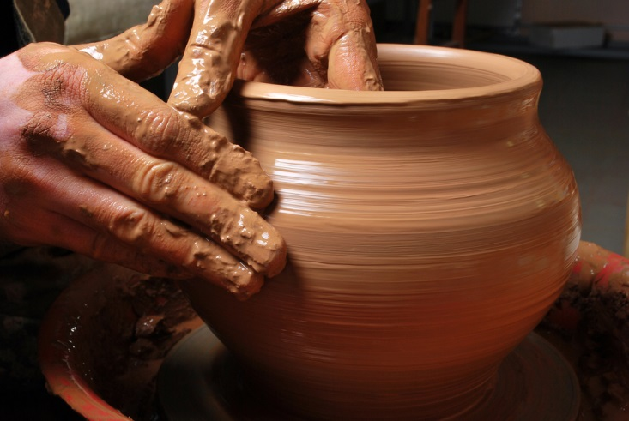



Effects of force
REST → MOTION
2. MOTION → REST
3 CHANGE IN SPEED
4. CHANGE IN DIRECTION
5. CHANGE IN SHAPE
FORCE (brakes / accelerator) is used to change the speed.
FORCE (Kick) is used to change from rest to motion
By its effects !!!!
How do you know there is force ?
Can Force be seen ?
No !!!!
effects
FORCE (mould) is used to change shape
So the different effects of force are
FORCE (caught) is used to change from motion to rest
FORCE (hit) is used to change the direction.
The player hits the ball to change the direction.
The potter is molding the clay.
The ball is caught by the fielder
By stepping brakes / accelerator speed changes
When the ball is kicked ball moves.

Slide 4





BALANCED FORCE
UNBALANCED FORCE
Are there different kinds of Forces?
Yes….!!!!!
1. Forces which are equal in magnitude and opposite in direction acting on the same body
1. Forces which are unequal in magnitude and acting on the same body
Both teams exert equal forces on the rope in opposite direction
Hence, both forces balance each other
2. Changes the state of rest or of motion. Causes acceleration in a body
2. They do not change the state of rest or of uniform motion
Change in velocity
time

Slide 5
LAWS OF MOTION
Galileo's Analysis on Motion
Inertia
Newton’s 1st Law of motion

Slide 6

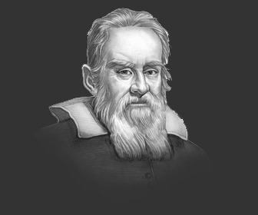

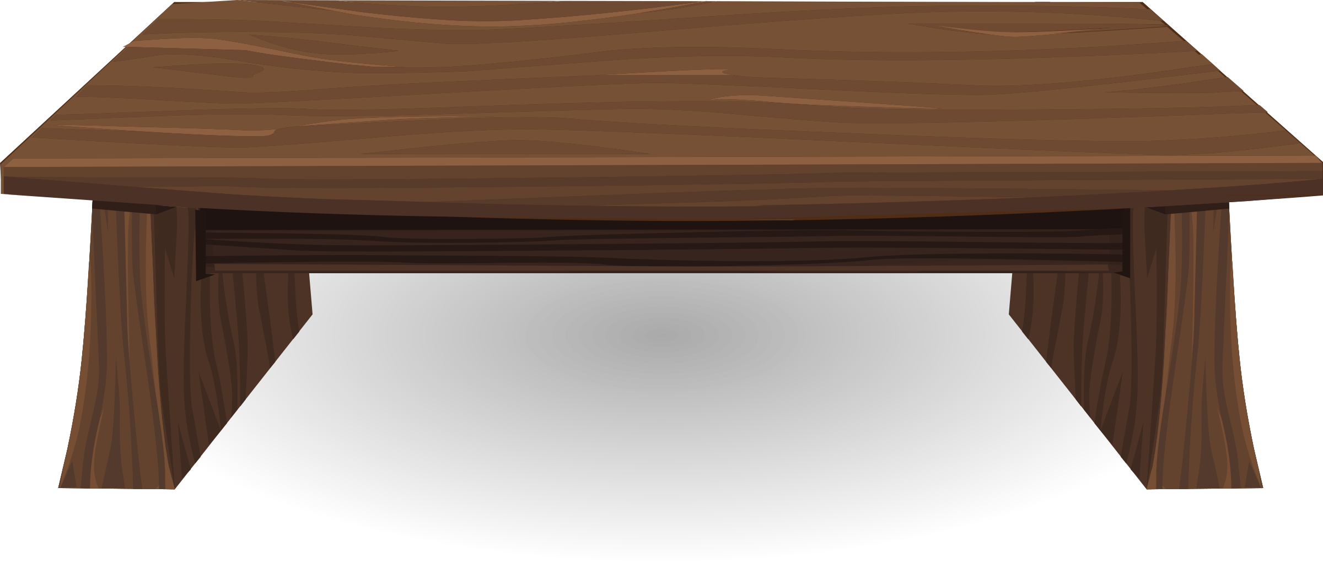
Galileo's Analysis on Motion
Galileo's Analysis on Motion
Galileo
Height
Height
When the marble is released from left, it would roll down the slope and go up on the opposite side to the same height from which it was released.

Slide 7
Galileo's Analysis on Motion
Galileo's Analysis on Motion
Height
Height
The angle of inclination of the right-side plane were gradually decreased, then the marble would travel further distances till it reaches the original height.

Slide 8
Galileo's Analysis on Motion
Galileo's Analysis on Motion
Galileo deduced that objects move with a constant speed when no force acts on them.
If the right-side plane were ultimately made horizontal, the marble would continue to travel forever trying to reach the same height that it was released from. The unbalanced forces on the marble in this case are zero

Slide 9

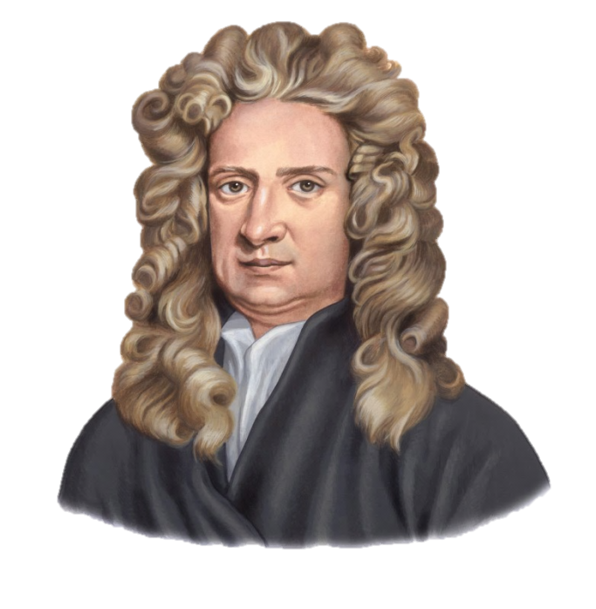
Newton’s Laws of Motion
Newton studied ideas on force and motion and presented three Fundamental Laws.
These Laws are known as…..
Newton’s Laws of Motion
Sir Isaac Newton

Slide 10


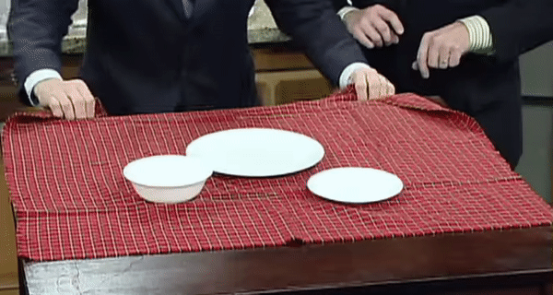
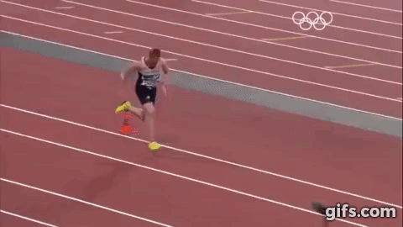
INERTIA
Inertia is the tendency of a body to resist change in its state of rest or state of motion.
Means to resist
Body at rest remains at rest
Body in motion remains in motion

Slide 11
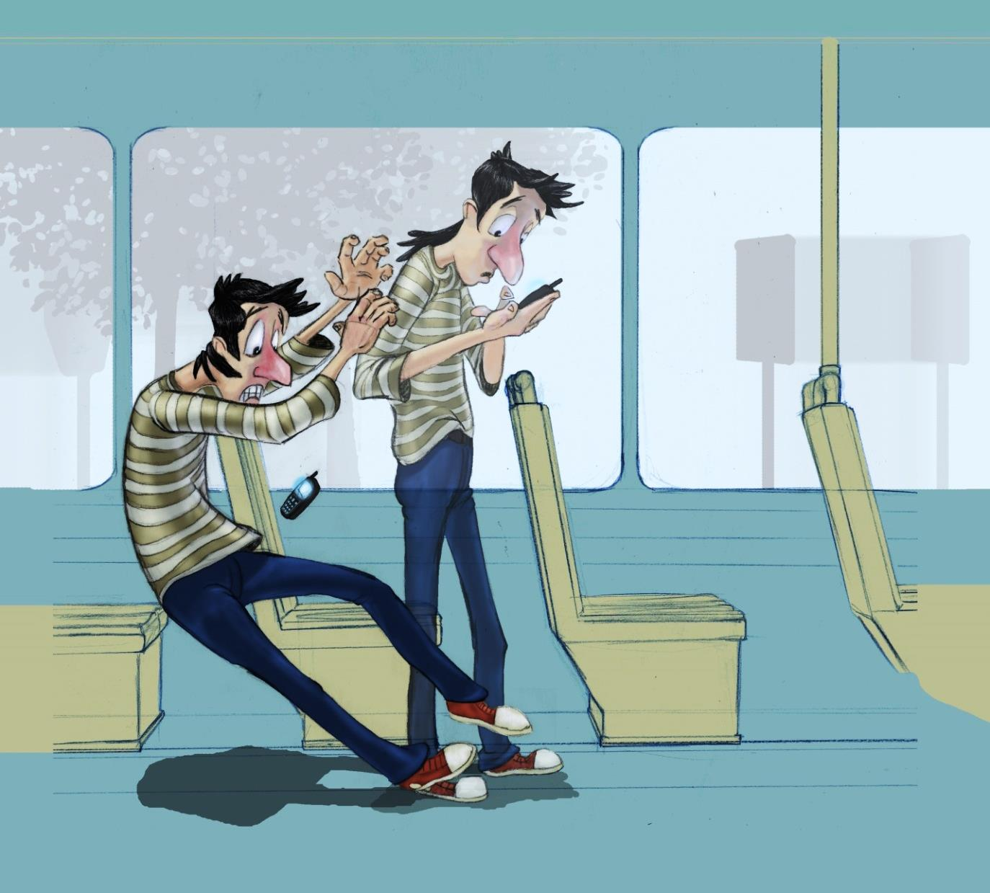
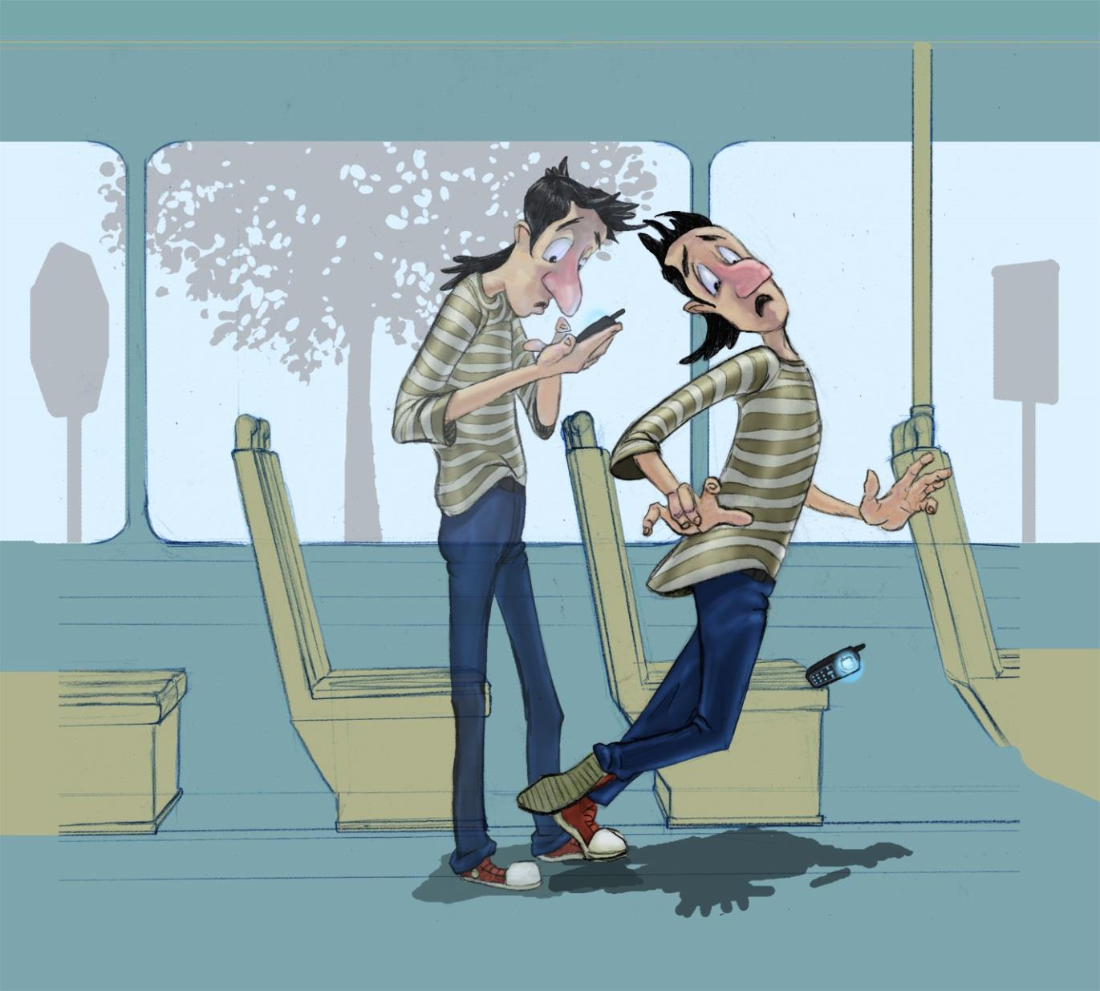
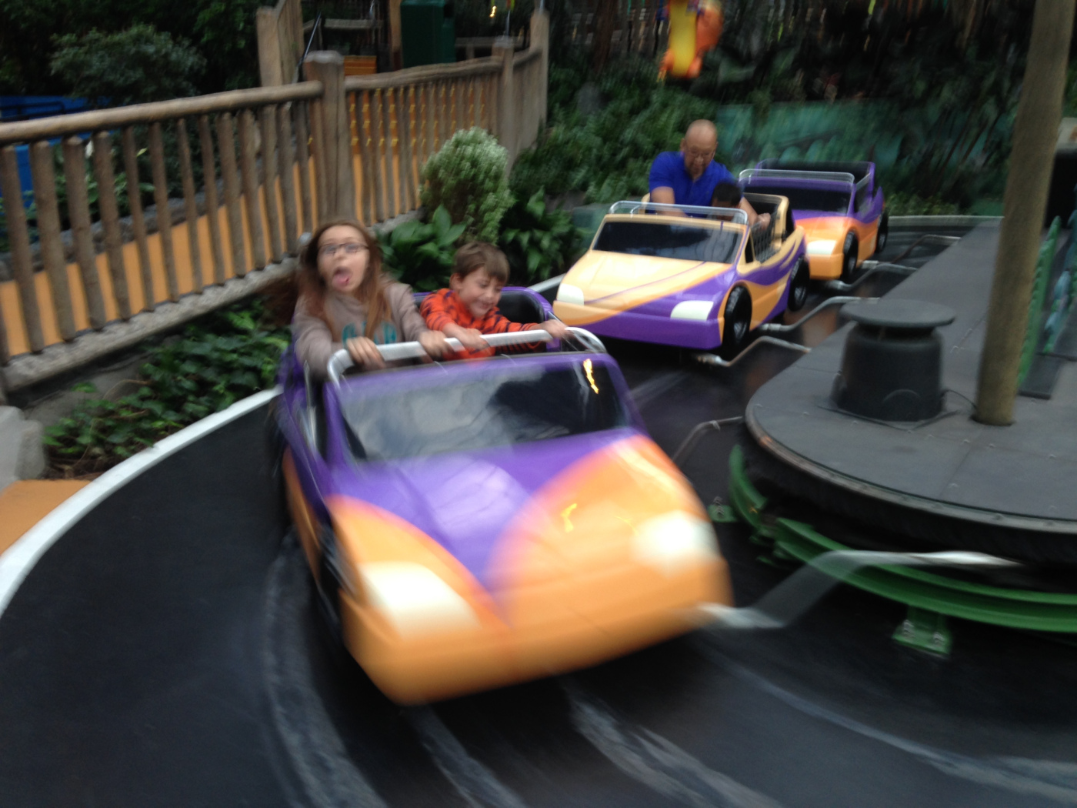
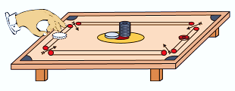
EXAMPLES OF INERTIA

Slide 12
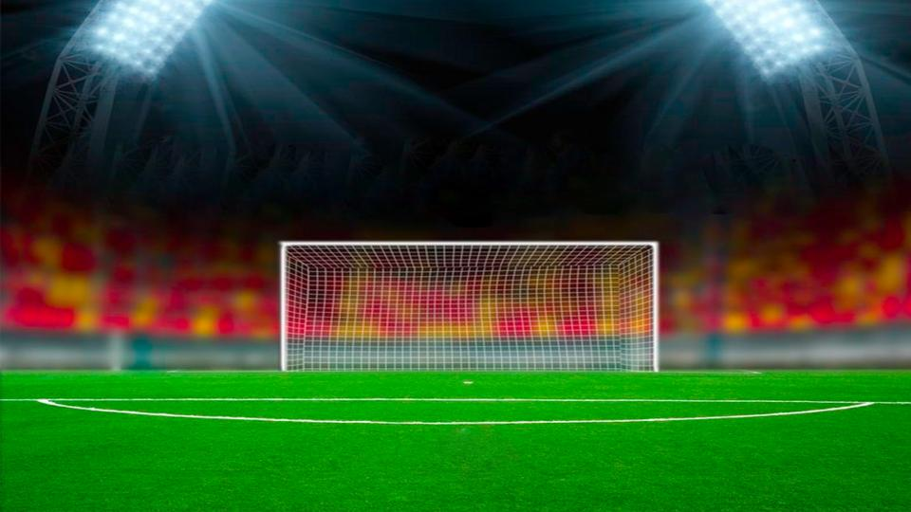
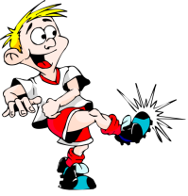

Newton’s first law of motion
Newton’s first law of motion is stated as:
An object remains in the state of rest or of uniform motion in a straight line unless compelled to change that state by an applied force.
The person kicks (unbalanced force) forces to change the state from rest to motion.
The ball is at rest and will continue to be at rest.
Lets us a consider an example
This law can be said in another way
This is why the first law of motion is known as
All objects resist a change in their state of motion
“The Law Of Inertia”
Is nothing but inertia.

Slide 13


Name the property of bodies to resist a change in their velocities.
Ans :
Inertia

Slide 14
Which of the following has more inertia: (a) a rubber ball and a stone of the same size? (b) a bicycle and a train (c) a five rupee coin and a one-rupee coin?
Ans :
(a) Stone
(b) Train and
(c) A five rupee coin
Heavier or more massive objects offer larger inertia.
Quantitatively, the inertia of an object is measured by its mass.

Slide 15
In the following example, try to identify the number of times the velocity of the ball changes:
“A football player kicks a football to another player of his team who kicks the football towards the goal. The goalkeeper of the opposite team collects the football and kicks it towards a player of his own team”.
Also identify the agent supplying the force in each case.
Ans :
The velocity of ball changes three times.
First time, the velocity changes when the FOOTBALL PLAYER of one team kicks the ball.
Second time, the velocity changes when ANOTHER PLAYER OF SAME TEAM kicks the football.
Third time, the velocity changes when the GOALKEEPER of the opposite team kicks the football.

Slide 16
Explain why some of the leaves may get detached from a tree if we vigorously shake its branch.
Ans :
Before shaking the branches, leaves are at rest. When branches are shaken, they come in motion while the leaves tend to remain at rest due to inertia of rest. As a result leaves get detached from the branches and fall down.

Slide 17
Why do you fall in the forward direction when a moving bus brakes to a stop and fall backwards when it accelerates from rest?
Or
(i) Why do the passengers in a bus tend to fall forward when it suddenly stops?
(ii) Why do the passengers in a bus tend to fall backward when it starts suddenly?
Ans :
(i) When a moving bus stops, the lower part of our body in contact with the bus comes to rest while the upper part of our body tends to keep moving due to inertia of motion. Hence, we fall downwards (or forwards).
(ii) When the bus accelerates from rest, the lower part of our body comes into motion along with the bus while the upper part of body teds to remain at rest due to inertia of rest. Hence we fall backwards.

Slide 18
LAWS OF MOTION
Momentum
Units

Slide 19


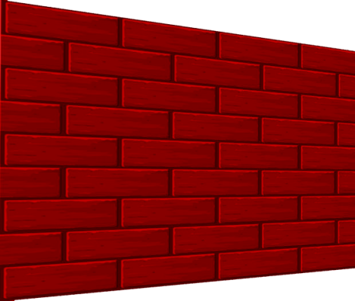

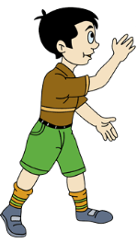



Let us understand what is momentum?
Impact
It depends on two factor, mass and velocity
But, It we take the same bullet and throw it towards the wall,
Lets us consider this example where we will fire a bullet towards the wall.
This is because, velocity of bullet is more, hence momentum is more
Bullet will penetrate
the wall
Bullet will not penetrate!!!
What will
happen??
Why?
The speed of the bullet is very less.
Therefore impact (momentum) is less

Slide 20

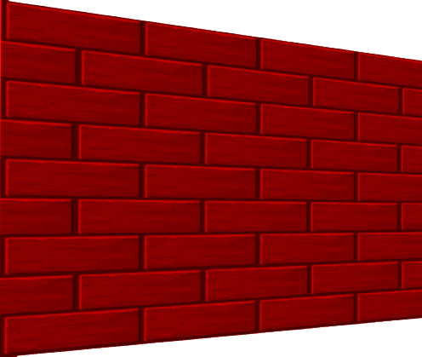
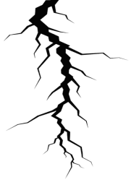


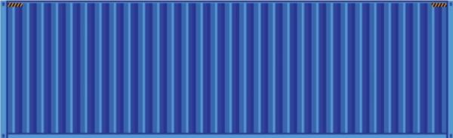
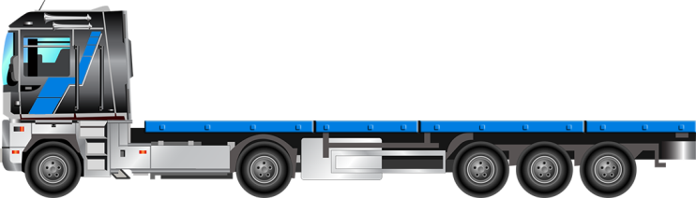

Let us consider another example !
The effect of one object striking another object depends both on the mass of the former object and its velocity.
But if a truck moving with a same velocity of 40m/s, hits the wall. Will it break ?
If a cycle moving with a velocity of
40 m/s hits the wall.
Mass of truck is more, hence impact is more.
Will the wall
break ?
YES
NO

Slide 21

MOMENTUM (P)
Momentum (P) of an object is defined as product of its mass and velocity
Momentum =
mass × velocity
P =
m × v
UNIT
P =
mv
P =
m ×
v
Momentum is a vector quantity
Needs both magnitude and direction
SI / MKS
P =
kg
m/s
CGS
P =
g
cm/s

Slide 22



Q. It is easy to stop a tennis ball than a cricket ball moving with the same velocity.
Sol :
Tennis ball
Cricket ball
Mass is less hence momentum is less
1. Momentum of an object depends on its mass as well as its velocity.
Mass is more hence momentum is more
2. Cricket ball is more heavy than a tennis ball. Although they are thrown with the same velocity, cricket ball has more momentum than a tennis ball.
3. Hence, more force is required to stop a cricket ball than a tennis ball.
4. Hence, it is easier to stop a tennis ball than a cricket ball moving with same velocity.

Slide 23
LAWS OF MOTION
Newton’s 2nd Law of motion
Mathematical formulation

Slide 24
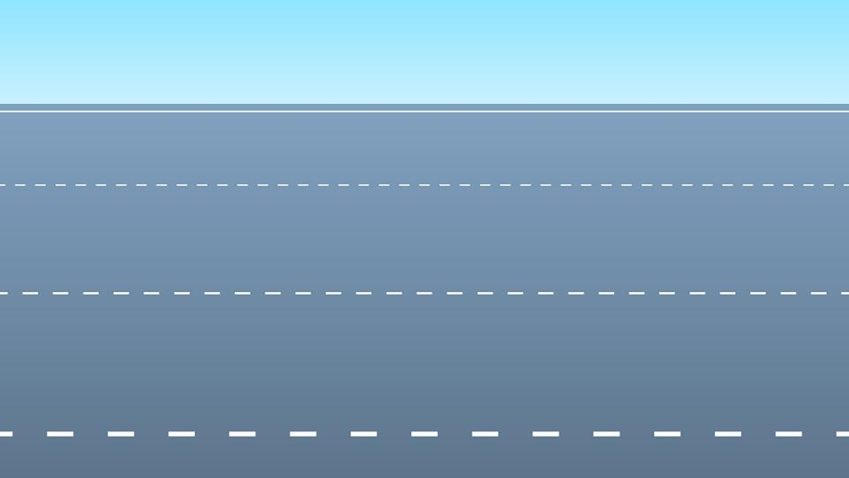





But a car requires only 30 sec to reach from 0 m/s to 50 m/s. Because the engine of the car exerts a strong force.
B
A
50 m/s
0 m/s
Cyclist applies force and requires 2 mins to reach from 0 m/s to 50 m/s.
Hence higher the force, faster will be the change in velocity.
Hence higher the force, faster will be the change in momentum.
B
A
50 m/s
0 m/s

Slide 25

NEWTON’S SECOND LAW OF MOTION
Newton’s second law of motion states that:
The second law of motion states that the rate of change of momentum of an object is proportional to the applied unbalanced force in the direction of force.
Let the car have mass
Let a force be applied
F
m
A
t
B
u m/s
Let its initial velocity be
v m/s
Let its final velocity be
For a time

Slide 26
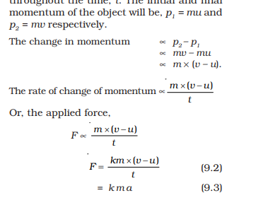
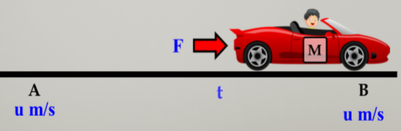

Mathematical Formulation of Second Law of Motion
According to second law of motion
P₁
=
mu
P₂
=
mv
Momentum = mass × velocity
Rate of change of momentum
Applied force
Rate of change of momentum is directly proportional to the
Applied force
Rate of Change of momentum
Change in momentum
∝
=
Let P₂ be the final momentum.
Let P₁ be the initial momentum.
‘a’ is the acceleration OR rate of change of velocity.
time
ma
∝
F
mv - mu
F
∝
ma
=
Final $−$ initial
With respect to time
t
F
=
kma
m
v-u
×
(v-u)
If
k
=
=
∴
a
=
1,
t
t
‘k’ is the proportionality constant.
F
=
Rate of Change of momentum
Then
ma
=
ma

Slide 27
LAWS OF MOTION
Force
Units
Distinguish between force and momentum

Slide 28
Force is a VECTOR quantity
m is Mass
a is acceleration
Force Equation
F
=
Needs both magnitude and direction
ma
kg
g
m/s²
cm/s²
units
SI/MKS
CGS
newton (N)
dyne

Slide 29

Let us define 1 newton & 1 dyne
F
=
ma
1 newton
=
1kg
×
1 m/s²
1 newton = The force necessary to cause an acceleration of 1 m/s² in an object of mass 1 kg is called 1 newton.
1 dyne
1g
1 cm/s²
=
×
1 dyne = The force necessary to cause an acceleration of 1 cm/s² in an object of mass 1 gm is called 1 dyne.

Slide 30
A truck of mass m is moved under a force F. If the truck is then loaded with an object equal to the mass of the truck and the driving force is halved, then how does an acceleration change?
Ans :
F
In first case :
a =
m
F/2
In first case :
a' =
m + m
1
F
a' =
.
4
m
1
=
a
4

Slide 31


Distinguish between force and momentum
1. It is a physical quantity that changes or tends to change the state of rest or of uniform motion of a body in a straight line.
1. It is the product of mass and velocity of the body.
2. The unit of force is newton in the MKS system and dyne in the CGS system.
2. In the MKS system, it is kg– m/s and g–cm/s in CGS system.
3. Force = mass × acceleration.
3. Momentum = mass × velocity

Slide 32
LAWS OF MOTION
Newton’s 3rd law of motion

Slide 33


NEWTON’S THIRD LAW OF MOTION
The third law of motion states that every action force has an equal and opposite reaction force which acts simultaneously.
The earth in turn exerts an equal and opposite force which will propel the rocket into space.
The fuel gases of rocket exerts a downward force on surface of the earth

Slide 34

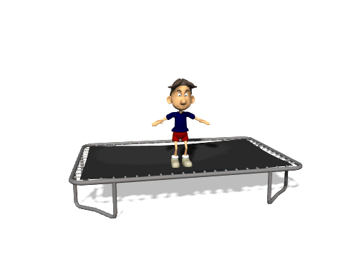
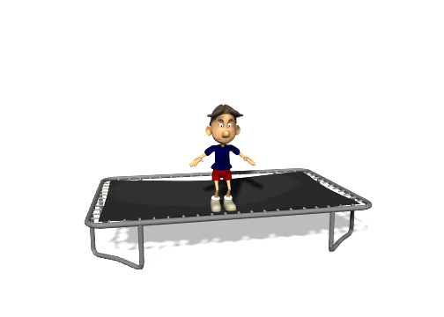
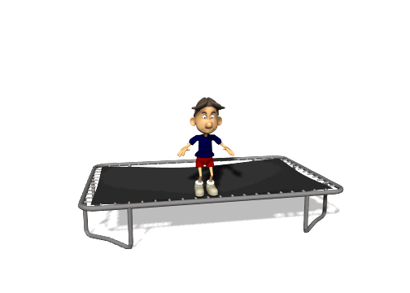
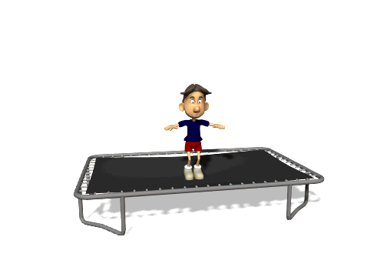
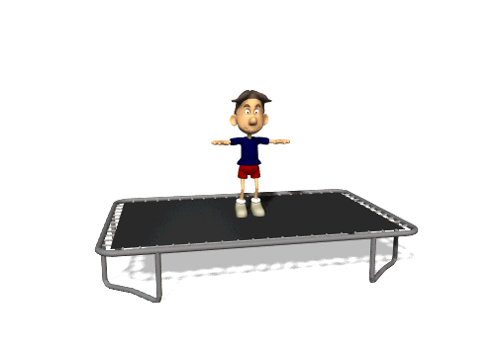
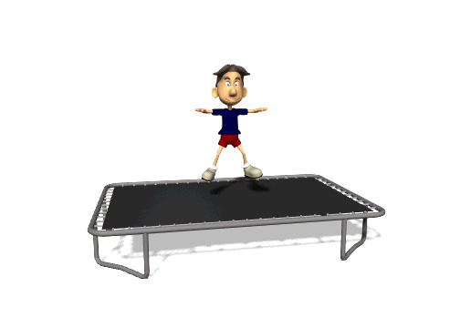
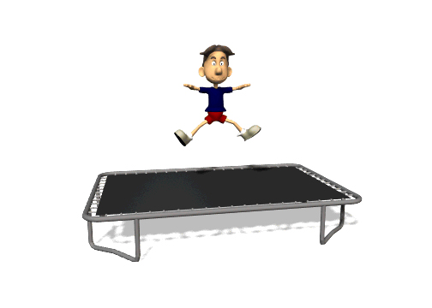
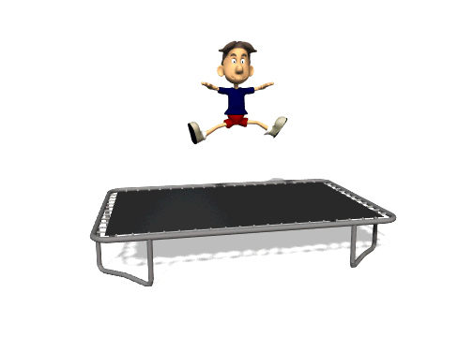

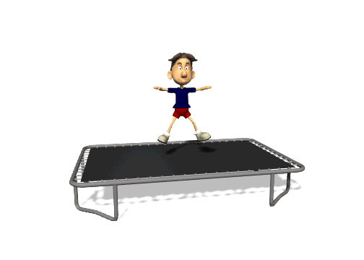
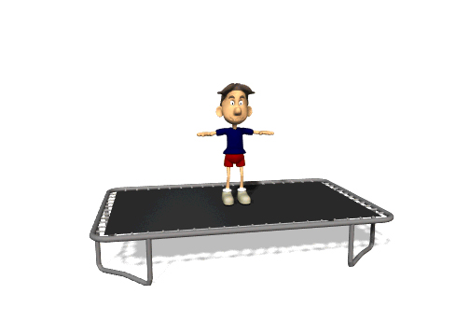
Lets us consider this example where the boy is on the trampoline.
What does Newton want to say in his Third Law?
When he is jumping he is applying a downward force on the trampoline.
Now the trampoline will exert an equal force but in the opposite direction.

Slide 35

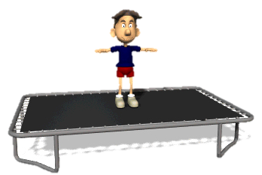

The Law speaks about :
1. Interaction between bodies.
Boy and trampoline.
2. These forces act in pairs. One force cannot exist by itself.
3. Action and reaction forces act simultaneously.
For every action there is a reaction which is equal and opposite.
At the same time. There is no delay
4. Force, though they are equal and opposite, they never cancel each other.
If the forces are equal and opposite they should cancel each other.
They do not act on the same object and hence cannot cancel each other’s effect.

Slide 36


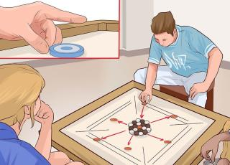
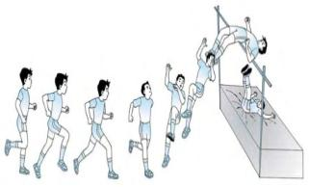
LET US REVISE THE THREE RULES
COLUMN - 1
COLUMN - 2
COLUMN - 3
Describe the relationship between the forces on two interacting objects.
In a high jump athletic event, the athletes are made to fall on a sand bed.
Newton's first law of motion
Newton's second law of motion
Gives an idea of the effects of force.
Motion of rocket
Only the carom coin at the bottom of a pile is removed when a fast moving striker hits it.
Newton's third law of motion
Also called as law of inertia.

Slide 37
Since action and reaction forces are always equal in magnitude and opposite in direction, how can anything ever be accelerated?
Or
“Action and reaction are equal and opposite but even then they do not cancel each other.” Give reason.
Ans :
This is because action and reaction act on different bodies.

Slide 38
A man is at rest in the middle of a pond on perfectly frictionless ice. How can he get himself to the shore?
Ans :
If the man throws away his shirt in a direction opposite to the desired direction of motion, he can get himself to the shore.

Slide 39
LAWS OF MOTION
Law of conservation of momentum

Slide 40




Law of conservation of momentum
When two objects collide, the total momentum before collision is equal to the total momentum after collision
F₂
F₁

Slide 41
Deduce the law of conservation of momentum from Newton’s third law of motion.
Ans :
As shown in Fig. consider two bodies A and B of masses m_{A} and m_{B} moving in the same direction along a straight line with velocities u_{A} and u_{B} respectively such that u_{A} > u_{B}. They collide for time t. After collision, let their velocities becomes v_{A} and v_{B}.
m_{A}
m_{B}
m_{A}
m_{B}
m_{A}
m_{B}
F_{BA}
F_{AB}
A
B
A
B
A
B
u_{A}
u_{B}
V_{A}
V_{B}
Before collision
During collision
After collision

Slide 42
Force exerted by A on B is
m_{A}(v_{A} – u_{A})
F_{AB}
=
Rate of change of momentum of A
=
t
Force exerted by B on A is
m_{B}(v_{B} – u_{B})
F_{BA}
=
=
Rate of change of momentum of B
t
According to Newton’s third law of motion,
Action
=
– Reaction
F_{AB}
=
– F_{BA}
m_{A}(v_{A} – u_{A})
m_{B}(v_{B} – u_{B})
=
–
t
t
m_{A}v_{A} – m_{A}u_{A}
=
– m_{B}v_{B} + m_{B}u_{B}
m_{A}u_{A} + m_{B}u_{B}
=
– m_{A}v_{A} – m_{B}v_{B}
Total momentum before collision
=
Total momentum after collision
Thus total momentum of the two bodies is conserved provided no external force acts on them. This proves the law of conservation of momentum.

Slide 43
LAWS OF MOTION
Conservation of momentum while firing a gun

Slide 44
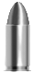
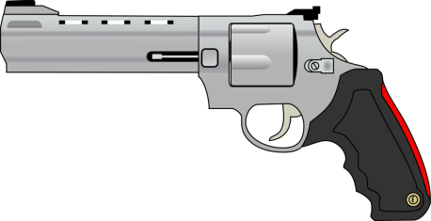
CONSERVATION OF MOMENTUM WHEN FIRING A GUN
Mass
(m₁)
(m₂)
Mass of Bullet
Mass of Gun
Initial velocity
(u₁)
(u₂)
Final velocity
(v₁)
(v₂)
Initial velocity of Bullet
(Before firing)
Initial velocity of Gun
(Before firing)
Final velocity of Bullet
(After firing)
Final velocity of Gun
(After firing)

Slide 45

CONSERVATION OF MOMENTUM WHEN FIRING A GUN
Total final momentum = Total initial momentum
m₁ v₁
+
m₂ v₂
= 0
= m₁ u₁
+
m₂ u₂
This backward motion of the gun is called RECOIL
Hence, Total initial momentum is zero
- m₁ v₁
– m₁ v₁
m₂ v₂
v₂
=
As gun and bullet are initially at rest, initially velocity is zero.
m₂
Negative indicates that the gun will move in the opposite direction
The velocity v₂ is called
RECOIL VELOCITY

Slide 46
LAWS OF MOTION
Type A - Numerical

Slide 47


Type - A
F = ma
numerical
v-u
a
=
t

Slide 48

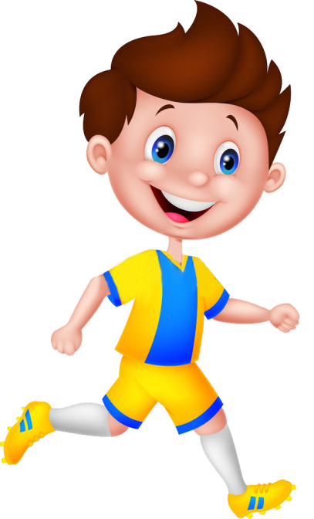

A constant force acts on an object of mass 5 kg for a duration of 2 s. It increases the object’s velocity from 3 m s⁻¹ to 7 m s⁻¹ . Find the magnitude of the applied force.
1
Force(F) = ?
Mass = 5 kg
Time(t) =2s
Final velocity(v) = 7 ms⁻¹
Initial velocity(u) = 3 ms⁻¹

Slide 49
A constant force acts on an object of mass 5 kg for a duration of 2 s. It increases the object’s velocity from 3 m s⁻¹ to 7 m s⁻¹ . Find the magnitude of the applied force.
1
Given :
Mass of the object (m)
=
5kg
Time (t)
=
2s
Initial velocity (u)
=
3 ms⁻¹
Final velocity (v)
=
7 ms⁻¹
To find :
Force (F)
=
?
(
-
u
v
)
Formulae :
F
=
ma
a
=
Ans :
t
Force acting on the object is 10 N.
(7 – 3)
Solution :
a
=
F
=
ma
2
4
=
5 × 2
∴
a
=
10N
2
=
∴
a
=
2ms⁻²

Slide 50
LAWS OF MOTION
Type A - Numerical

Slide 51

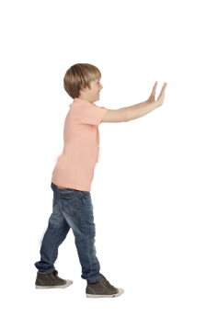
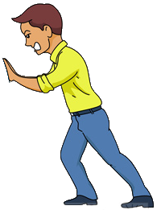

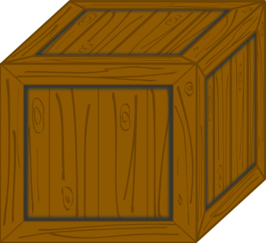
2
Which would require a greater force - accelerating a 2 kg mass at 5ms⁻² or a 4 kg mass at 2ms⁻² ?
A
B
Mass
m₁=2 kg
m₂=4 kg
Who has a greater force?
Acceleration
a₁=5 ms⁻²
a₂=2 ms⁻²
A
B
Acceleration (a) = 5ms⁻²
Acceleration (a) = 2ms⁻²
Mass(m) =2kg
Mass(m) =4kg

Slide 52
2
Which would require a greater force - accelerating a 2 kg mass at 5ms⁻² or a 4 kg mass at 2ms⁻² ?
Given :
Mass of 1st object (m₁)
=
2 kg
Mass of the 2nd object (m₂)
=
4 kg
Acceleration of the 1st object (a₁)
=
5ms⁻²
Acceleration of the 2nd object (a₂)
=
2ms⁻²
To find :
F₁
>
F₂
or
F₂
>
F₁
(ii)
F₂
=
m₂
a₂
Formula :
F
=
ma
∴
F₂
=
4
×
2
∴
F₂
=
8N
Solution :
(i)
F₁
=
m₁
a₁
F₁
>
F₂
F₁
=
2
∴
×
5
Ans :
∴
F₁
=
10N
Accelerating a 2 kg mass at
5ms⁻² requires a greater force.

Slide 53
Two persons manage to push a motorcar of mass 1200 kg at a uniform velocity along a level road. The same motorcar can be pushed by three persons to produce an acceleration of 0.2 ms⁻². With what force does each person push the motorcar?
(Assume that all persons push the motorcar with the same muscular effort.)
3
Given :
m
= 1200 kg
Ans :
Each person applies a force of magnitude 80 N
a
= 0.2 m s^{–2}
To find :
F
= ?
Formula :
F
= ma
Solution :
F
= ma
∴
F
= 1200
× 0.2
∴
F
= 240 N
Force Exerted by Each Person
240
= 80 N
=
3

Slide 54
LAWS OF MOTION
Type A - Numerical

Slide 55
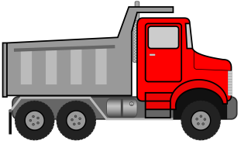
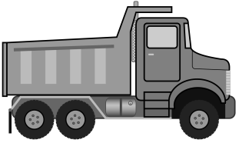
A truck starts from rest and rolls down a hill with a constant acceleration. It travels a distance of 400 m in 20s. Find its acceleration. Also find the force acting on it if its mass is 7 tonnes.
4
(Hint : 1 tonne = 1000 kg.)
Initial velocity(u) = 0 ms⁻¹
a = ?
F = ?
time(t) =20s
Distance=400m
Mass(m) =7 tonnes

Slide 56
A truck starts from rest and rolls down a hill with a constant acceleration. It travels a distance of 400 m in 20s. Find its acceleration. Also find the force acting on it if its mass is 7 tonnes ( Hint:1 tonne = 1000 kg.)
4
Given :
Initial velocity (u)
=
0 ms⁻¹
Distance travelled (s)
=
400 m
Time (t)
=
20 s
Mass of truck (m)
=
7 tonnes
400
×
2
=
400
a
=
7000 kg
400
×
2
2ms⁻²
To find :
Acceleration (a)
=
?
∴
a
=
400
=
Force (F)
=
?
F
=
a
(ii)
m
Formulae :
1
m
∴
F
=
7000 × 2
(i)
s
u
t
+
t²
(ii)
=
a
=
2
a
F
∴
F
=
14000N
1
(i)
s
=
u
t
+
a
Solution :
2
t²
Ans :
1
a
The truck moves with an acceleration of 2ms⁻² and the force acting on it is 14000 N .
400
=
0 × 20
+
×
20 × 20
2

Slide 57


5
A hammer of mass 500 g, moving at 50 ms⁻¹, strikes a nail. The nail stops the hammer in a very short time of 0.01 s. What is the force of the nail on the hammer?
Mass (m) = 500 g
Initial Velocity (u) = 50 ms⁻¹
Final Velocity (v) = 0 ms⁻¹
Force (F) = ?
Time (t) = 0.01 s

Slide 58
5
A hammer of mass 500 g, moving at 50 ms⁻¹, strikes a nail. The nail stops the hammer in a very short time of 0.01 s. What is the force of the nail on the hammer?
500
– 50
Given :
m
= 500 g
=
∴
a
=
1000
0.01
= 0.5 kg
∴
a
=
- 5000 m s^{–2}
u
= 50 ms^{–1}
F
= ma
The –ve sign shows that the body is retarding
t
= 0.01 s
∴
F
= 0.5 × - 5000
v
= 0 ms^{–1}
∴
F
= - 2500N
To Find :
F
= ?
Ans:
v - u
Formulae :
(i)
a =
The force acting on the nail is -2500N. The negative sign shows that friction force being exerted.
t
(ii)
F
= ma
v - u
0 – 50
Solution :
a =
=
t
0.01

Slide 59
LAWS OF MOTION
Type A - Numerical

Slide 60

When the stone hits the surface of ice the stone comes to a rest.
6
A stone of 1 kg is thrown with a velocity of 20ms⁻¹ across the frozen surface of a lake and comes to rest after travelling a distance of 50 m. What is the force of friction between the stone and the ice?
The negative sign shows that the force is acting in the direction opposite to that of the motion.
The stone moves with the velocity of 20ms⁻¹
The mass of the stone 1 kg.

Slide 61



6
A stone of 1 kg is thrown with a velocity of 20ms⁻¹ across the frozen surface of a lake and comes to rest after travelling a distance of 50 m. What is the force of friction between the stone and the ice?
Mass(m) =1kg
Initial Velocity (u) = 20 ms⁻¹
Final Velocity (v) = 0 ms⁻¹
Distance (d) = 50m
Force (F) = ?

Slide 62
6
A stone of 1 kg is thrown with a velocity of 20m s⁻¹ across the frozen surface of a lake and comes to rest after travelling a distance of 50 m. What is the force of friction between the stone and the ice?
Given:
Mass of the stone (m)
=
1 kg
∴
a
=
– 4ms⁻²
[-ve sign shows the retardation]
Initial velocity (u)
=
20 ms⁻¹
Final velocity (v)
=
0 ms⁻¹
(ii)
F
=
ma
Distance travelled (s)
=
50 m
∴
F
=
1
×
– 4
∴
F
=
– 4N
To Find:
Force of friction (F)
=
?
Formulae:
(i)
F
=
ma
Ans:
Force of friction between ice and stone is – 4N
(ii)
v²
=
u²
+
2as
Solution :
(i)
v²
=
u²
+
2as
The –ve sign shows that the Force is acting in the opposite direction of the motion
2as
=
v²
–
u²
2as
=
0² – 20²
– 8
– 400
a
=
2
×
50

Slide 63
LAWS OF MOTION
Type A - Numericals

Slide 64




8000 kg engine pulls a train of 5 wagons, each of 2000 kg along a horizontal tracks. If the engine exerts a force of 40000 N and the track offers a friction force of 5000 N. Then calculate: (a) The net accelerating force (b) The acceleration of the train (c)The force of wagon 1 on wagon 2.
7
Mass of each wagon =2000kg
Mass(m) =8000kg
Force(F) =40000N
Force of Friction =5000N

Slide 65
A 8000 kg engine pulls a train of 5 wagons, each of 2000 kg along a horizontal tracks. If the engine exerts a force of 40000 N and the track offers a friction force of 5000 N. Then calculate: (a)The net accelerating force (b)The acceleration of the train (c)The force of wagon 1 on wagon 2.
7
Given :
Mass of engine
=
8000kg
Mass of each wagon
=
2000kg
Force Exerted By Engine
=
40000N
Friction force
=
5000N
To Find :
(a) Net accelerating force
(b)Acceleration of the train
(c) The force of wagon 1 on wagon 2
=
?
=
?
=
?
Formulae :
(a) Net accelerating force
=
Force exerted by engine
-
Force exerted by tracks
(b) F = ma
Acceleration of the train
F
(b)
Total Mass = Mass of Engine + Total mass of 5 Wagons
Total Mass = 8000 + 5(2000)
= 8000 + 10000
(a)
Solution :
=
m
(a) Net accelerating force
Force exerted by engine
Force exerted by tracks
∴
a
35000
=
-
=
=
1.94 ms⁻²
18000
=
40000
-
5000
Force of Wagon 1 on Wagon 2
Mass of 4 wagons behind wagon 1
(c)
=
×
a
=
35000N

Slide 66
A 8000 kg engine pulls a train of 5 wagons, each of 2000 kg along a horizontal tracks. If the engine exerts a force of 40000 N and the track offers a friction force of 5000 N. Then calculate: (a)The net accelerating force (b)The acceleration of the train (c)The force of wagon 1 on wagon 2.
7
Given :
Mass of engine
=
8000kg
Mass of each wagon
=
2000kg
Force Exerted By Engine
=
40000N
Friction force
=
5000N
To Find :
(a) Net accelerating force
(b)Acceleration of the train
(c) The force of wagon 1 on wagon 2
=
?
=
?
=
?
Formulae :
(a) Net accelerating force
=
Force exerted by engine
-
Force exerted by tracks
(b) F = ma
Acceleration of the train
F
(b)
(a)
Solution :
=
m
(a) Net accelerating force
Force exerted by engine
Force exerted by tracks
∴
a
35000
=
-
=
=
1.94 ms⁻²
18000
=
40000
-
5000
Force of Wagon 1 on Wagon 2
Mass of 4 wagons behind wagon 1
(c)
=
×
a
=
35000N
∴
F
=
=
8000 × 1.94
15520N

Slide 67
LAWS OF MOTION
Type A - Numerical

Slide 68


An Auto Mobile vehicle has mass of 1500kg. What must be the force between the vehicle and road if the vehicle is to be stopped with a negative acceleration of 1.7 ms⁻² ?
8
Mass(m) =1500kg
Final Velocity (v) =0ms⁻¹
Frictional Force (F) = ?
Negative Acceleration
(a) = 1.7 ms⁻²

Slide 69
An Auto Mobile vehicle has mass of 1500kg. What must be the force between the vehicle and road if the vehicle is to be stopped with a negative acceleration of 1.7 ms⁻² ?
8
Given :-
Mass of automobile (m)
=
1500 kg
acceleration (a)
=
-1.7ms⁻²
To Find:
Force of friction (F)
=
?
Formula:
F
=
ma
Solution :
F
=
ma
F
=
1500
×
-1.7
The –ve sign shows that the Force is acting in the opposite direction of the motion
F
=
- 2550 N
Answer:
The Force between the vehicle and the road is -2550 N.

Slide 70
A force of 5N gives a mass m₁, an acceleration of 10ms⁻² and a mass m₂, an acceleration of 20ms⁻². What acceleration would it give if both the masses were tied together?
9
F
m₂ × a₂
Given:
a₁
=
10 ms⁻²
a₂
=
20 ms⁻²
=
F
=
5 N
F
m₂
=
To Find:
Total acceleration (a)
?
a₂
=
5
1
m₂
=
=
=
0.25kg
Formula:
(i)
F
=
ma
20
4
Total Mass
=
0.5 + 0.25
=
0.75kg
Solution:
F
=
ma
F
=
m₁ × a₁
F
=
ma
F
F
5
m₁
=
a
=
=
=
6.67 ms⁻²
a₁
m
0.75
5
1
Ans:
The total acceleration produced is 6.67 ms⁻².
m₁
=
=
=
0.5kg
10
2

Slide 71
LAWS OF MOTION
Type A - Numericals

Slide 72


The velocity-time graph of a ball of mass 20g moving along a straight
line on a long table is given in the figure. How much force does the
table exert on the ball to bring it to rest?
10
25
20
Force of Friction (F) = ?
Velocity (cm/s) →
15
10
5
Initial Velocity (u) =20cms⁻¹
1
2
3
4
5
6
7
8
9
10
11
Mass(m) =20g
time (s) →
Final Velocity (v) =0ms⁻¹

Slide 73
10
The velocity-time graph of a ball of mass 20g moving along a straight
line on a long table is given in the figure. How much force does the
table exert on the ball to bring it to rest?
20
25
=
20 g
Given :
Mass of ball (m)
=
=
0.02 kg
1000
20
Initial velocity (u)
=
20 cms⁻¹
=
0.2 ms⁻¹
Velocity (cm/s) →
15
Final velocity (v)
=
0 cms⁻¹
=
0 ms⁻¹
10
Time taken (t)
=
10 s
5
1
2
3
4
5
6
7
8
9
10
11
To Find :
Force of friction on the ball (F)
=
?
F
=
m
a
time (s) →
-
u
v
(-0.02)
(a)
a
0.02
=
-0.0004 N
Formulae :
F
=
m
a
(b)
=
∴
F
=
×
t
0
-
0.2
Ans:
Solution :
a
=
10
Force exerted is -0.0004N. The negative sign shows that friction force is exerted by the table.
a
=
-0.02ms⁻²
Acceleration of the ball in – 0.02ms⁻²

Slide 74





A motorcar is moving with a velocity of 108km/h and it takes 4s to stop after the brakes are applied. Calculate the force exerted by the brakes on the motorcar if its mass along with the passengers is 1000kg.
11
Force (F) = ?
Final Velocity(v) = 0 km/h
Initial Velocity(u) = 108 km/h
Mass(m) = 1000 kg
Time(t) = 4 s

Slide 75
A motorcar is moving with a velocity of 108km/h and it takes 4s to stop after the brakes are applied. Calculate the force exerted by the brakes on the motorcar if its mass along with the passengers is 1000kg.
11
u
5
=
Given :
=
108km/h
=
×
30 ms⁻¹
F
108
=
ma
18
v
=
0 ms⁻¹
F
1000 × - 7.5
=
t
=
4s
F
=
-7500 N
m
=
1000kg
Ans:
To Find:
F
=
?
Force exerted by the brakes is 7500N. Negative sign indicates retarding force.
v - u
Formulae:
(i)
F
a
=
(ii)
=
ma
t
The –ve sign shows that the body is retarding
v - u
0 - 30
- 30
Solution:
a
=
=
=
t
4
4
∴
a
=
- 7.5 ms⁻²

Slide 76
LAWS OF MOTION
Type A - Numericals

Slide 77




A bullet of mass 10 g travelling horizontally with a velocity of 150 ms⁻¹ strikes a stationary wooden block and comes to rest in 0.03 s. Calculate the distance of penetration of the bullet into the block. Also calculate the magnitude of the force exerted by the wooden block on the bullet.
12
Velocity(u) =150ms⁻¹
Force (F) = ?
Time(t) =0.03 s
Mass(m) =10g
Distance of penetration

Slide 78
A bullet of mass 10 g travelling horizontally with a velocity of 150 ms⁻¹ strikes a stationary wooden block and comes to rest in 0.03 s. Calculate the distance of penetration of the bullet into the block. Also calculate the magnitude of the force exerted by the wooden block on the bullet.
12
Solution:
v
u
=
+
a
t, 0
=
150
+
a
×
0.03
Given :
mass
(m)
=
10
g
=
0.01
kg
0.03
a
=
-
150
- 5000
Initial velocity
(u)
=
150
ms⁻¹
-
150
-
a
=
=
15000
=
-
5000
ms⁻²
Final velocity
(v)
=
0
ms⁻¹
0.03
3
time taken
(t)
=
0.03
v²
=
u²
+
2as
s
2as
=
v²
-
u²
-ve Sign shows that it is retardation
To Find :
(a)
distance travelled
(s)
=
?
2as
=
0
-
u²
(
×
)
9
(b)
force exerted
=
?
-
150
150
=
=
(F)
s
=
2.25
×
(
)
4
-
2
5000
-ve Sign shows that it is Force of Friction
v
=
u
+
a
Formulae:
t
penetration
=
m
Distance
of
2.25
=
a
F
m
v²
=
u²
+
2as
=
×
-
F
0.01
5000
=
-
50 N
=
a
F
m

Slide 79
LAWS OF MOTION
Type B - Numerical

Slide 80
Type - B
p = mv
numerical
Δp = mv - mu

Slide 81



An object of mass 100 kg is accelerated uniformly from a velocity of 5 ms⁻¹ to 8 ms⁻¹ in 6s. Calculate the initial and final momentum of the object. Also find the magnitude of the force exerted on the object.
1
Velocity(v) = 8 ms⁻¹
Initial Velocity(u) = 5 ms⁻¹
Time(t) = 6s
Mass(m) =100kg

Slide 82
An object of mass 100 kg is accelerated uniformly from a velocity of 5 ms⁻¹ to 8 ms⁻¹ in 6s. Calculate the initial and final momentum of the object.
Also find the magnitude of the force exerted on the object.
1
Solution:
Given:
Mass (m)
=
100 kg
(a) Initial momentum (p₁)
=
mu
Initial velocity (u)
=
5 ms⁻¹
=
100
×
5
=
500
kg ms⁻¹
Final velocity (v)
=
8 ms⁻¹
(b) Final momentum (p₂)
=
mv
Time taken (t)
=
6 s
=
100
To Find:
(a) Initial momentum (p₁)
×
8
=
800
kg ms⁻¹
=
?
(b) Final momentum (p₂)
v-u
=
?
(c) a
=
t
F
(c) Force exerted (F)
=
?
=
ma
-
8
5
∴
F
=
100
×
∴
a
=
0.5
Formulae:
(a) p
ma
=
mv
(b) F
=
6
₁
∴
F
=
50
v-u
3
N
(c) a
=
∴
a
=
t
6
₂
Force exerted is 50 N
∴
a
=
0.5
ms⁻²

Slide 83
A hockey ball of mass 200 g travelling at 10 ms^{–1} is struck by a hockey stick so as to return it along its original path with a velocity at 5 ms^{–1}. Calculate the change of momentum occurred in the motion of the hockey ball by the force applied by the hockey stick.
2
200
Given:
m
= 200g
=
= 0.2 kg
1000
The negative sign indicates that the object is moving in opposite direction
u = 10 m/s
v = - 5 m/s
To Find:
Change of momentum (Δp) = ?
Formulae:
Δp = mv - mu
Solution:
Δp = mv - mu
Δp = (0.2 × -5) – (0.2 × 10)
Δp = -1 - 2
The negative sign indicates that the object is moving in opposite direction
Δp = - 3 kgms⁻¹
Ans:
Change of momentum is 3kgms⁻¹.

Slide 84
LAWS OF MOTION
Type B - Numerical

Slide 85



How much momentum will a dumb-bell of mass 10 kg transfer to the floor if it falls from a height of 80 cm ? Take its downward acceleration to be 10 ms⁻².
3
Acceleration (a) = 10 ms⁻².
Mass(m) =10kg
Height(h) = 80 cm

Slide 86
How much momentum will a dumb-bell of mass 10 kg transfer to the floor if it falls from a height of 80 cm ? Take its downward acceleration to be 10 ms⁻².
3
Given :
mass (m)
=
10 kg
Solution :
v²
=
u²
+
2as
height (s)
=
80 cm
∴
v²
=
0²
+
2
×
10
×
0.8
80
v²
=
16
=
=
0.8 m
0.8
100
∴
v
=
√16
Acceleration (a)
=
10 ms⁻²
v
=
4
4 ms⁻¹
Initial velocity (u)
=
0 ms⁻¹
p
=
mv
To Find :
Momentum (p)
=
?
∴
p
=
10
×
4
∴
p
=
40 kg ms⁻¹
Formulae :
a)
p
=
mv
Ans:
The momentum transferred to the floor is 40 kgms⁻¹.
b)
v²
=
u²
+
2as

Slide 87
A motorcar of mass 1200 kg is moving along a straight line with a uniform velocity of 90 km/h. Its velocity is slowed down to 18 km/h in 4 s by an unbalanced external force. Calculate the acceleration and change in momentum. Also calculate the magnitude of the force required.
4
Mass(m) = 1200 Kg
Initial Velocity(u) = 90 km/h
Final Velocity(v) = 18 km/h
Time(t) = 4 s

Slide 88
A motorcar of mass 1200 kg is moving along a straight line with a uniform velocity of 90 km/h. Its velocity is slowed down to 18 km/h in 4 s by an unbalanced external force. Calculate the acceleration and change in momentum. Also calculate the magnitude of the force required.
4
Formulae :
v
-
u
Given :
Mass (m)
=
1200 kg
a
=
t
Initial velocity (u)
=
90 km/h
Change in momentum
mv
-
mu
F
ma
5
=
=
5
=
90
×
m/s
Solution :
18
1
=
25 ms⁻¹
v
-
u
5
-
25
-20
a
(i)
=
=
=
=
-5 ms⁻²
Final velocity (v)
=
18 km/h
t
4
4
1
5
=
18
×
m/s
Change in momentum
m
( v
-
=
mv
u )
-
(ii)
mu
=
1200
(
-
)
18
=
5
25
=
5 ms⁻¹
1
-20
-24000 kg ms⁻¹
=
1200
=
Time taken (t)
=
4 s
×
(iii)
Force exerted (F)
ma
-5
=
=
-6000 N
1200
To Find :
(i)
Acceleration (a)
=
?
=
×
(ii)
Change in momentum
=
?
Acceleration is 5ms⁻² and the change in momentum is 24000kgms⁻¹. The magnitude of force is 6000N
Ans:
(iii)
Force exerted (F)
=
?

Slide 89
LAWS OF MOTION
Type C - Numerical

Slide 90
Type - C
m₁u₁ + m₂ u₂ = m₁v₁ + m₂ v₂
Where,
numerical
u
=
Initial velocity
m
=
Mass of the body
v
=
Final velocity
Note:
Total Momentum before collision = Total Momentum after collision

Slide 91




A bullet of mass 20 g is horizontally fired with a velocity 150 ms⁻¹ from a pistol of mass 2 kg. What is the recoil velocity of the pistol?
1
Mass (m₁) = 20 g
Mass (m₂) = 2 kg
Final Velocity (v₂) = ?
Initial Velocity (u₂) = 0 ms⁻¹
Final Velocity (v₁) = 150 ms⁻¹
Initial Velocity (u₁) = 0 ms⁻¹

Slide 92
A bullet of mass 20 g is horizontally fired with a velocity 150 ms⁻¹ from a pistol of mass 2 kg. What is the recoil velocity of the pistol?
1
Mass of the bullet (m₁)
=
20 g
Given:
Solution:
m₁
u₁
+
m₂
u₂
=
m₁
v₁
=
0.02 kg
+
m₂
v₂
0.02
v₂
(
×
0
)
+
2
(
×
0
)
=
0.02
(
×
150
)
+
(
2
Mass of the pistol (m₂)
=
2 kg
×
)
Initial velocity of bullet (u₁)
=
0 ms⁻¹
0
=
(
+
2
3
)
v₂
Initial velocity of pistol (u₂)
=
0 ms⁻¹
2
-
v₂
=
3
Final velocity of bullet (v₁)
=
150 ms⁻¹
-
3
∴
v₂
=
2
∴
v₂
=
-
1.5
To Find:
Recoil velocity of pistol (v₂)
ms⁻¹
=
?
Ans:
Recoil velocity of the pistol is -1.5ms⁻¹. Negative sign shows that the pistol moves in the opposite direction of bullet.
Formula:
m₁
u₁
+
m₂
u₂
=
m₁
v₁
+
m₂
v₂

Slide 93
From a rifle of mass 4 kg, a bullet of mass 50 g is fired with an initial velocity of 35 ms⁻¹. Calculate the recoil velocity of the rifle.
2
Mass (m₁) = 50 g
Mass (m₂) = 4 kg
Final Velocity (v₂) = ?
Initial Velocity (u₂) = 0 ms⁻¹
Final Velocity (v₁) = 35 ms⁻¹
Initial Velocity (u₁) = 0 ms⁻¹

Slide 94
From a rifle of mass 4 kg, a bullet of mass 50 g is fired with an initial velocity of 35 ms⁻¹. Calculate the recoil velocity of the rifle.
2
Given :
m₂
50
∴
v₂
=
-0. 4375 ms⁻¹
=
4 kg,
m₁
=
50 g
=
= 0.05 kg
u₂
1000
u₁
=
0 ms⁻¹
=
0 ms⁻¹
Ans:
v₁
=
35 ms⁻¹
The rifle recoils with a velocity of 0.4375 ms⁻¹. The negative sign indicates that the rifle recoils backwards.
To Find:
v₂
=
?
Formula:
m₁u₁ + m₂u₂ = m₁v₁ + m₂v₂
Solution:
m₁u₁
+ m₂u₂
=
m₁v₁
+ m₂v₂
∴
(0.05 × 0) + (4 × 0)
=
(0.05 × 35) + (4 × v₂)
∴
0
=
1.75 + 4v₂
∴
-4v₂
=
1.75
-1.75
∴
v₂
=
4

Slide 95
LAWS OF MOTION
Type C - Numericals

Slide 96


A girl of mass 40 kg jumps with a horizontal velocity of 5 ms⁻¹ onto a stationary cart with frictionless wheels. The mass of the cart is 3 kg. What is her velocity as the cart starts moving ? Assume that there is no external unbalanced force working in the horizontal direction.
3
Initial Velocity(u₁) = 5ms⁻¹
Mass (m₁) = 40kg
Final Velocity (v) = ?
Mass (m₂) = 3kg
Initial Velocity(u₂) = 0ms⁻¹

Slide 97
A girl of mass 40 kg jumps with a horizontal velocity of 5 ms⁻¹ onto a stationary cart with frictionless wheels. The mass of the cart is 3 kg. What is her velocity as the cart starts moving ? Assume that there is no external unbalanced force working in the horizontal direction.
3
Given :
Mass of the girl (m₁)
=
40 kg
Mass of the cart (m₂)
=
3 kg
200
v =
= 4.65 ms⁻¹
Initial velocity of girl (u₁)
=
5 ms⁻¹
43
Initial velocity of cart (u₂)
=
0 ms⁻¹
Ans:
Her velocity as the cart starts moving is 4.65 ms⁻¹.
To find :
Final velocity of girl (v)
=
?
Formula :
m₁
u₁
+
m₂
u₂
=
m₁
v₁
+
m₂
v₂
Solution :
m₁
u₁
+
m₂
u₂
=
m₁
v₁
+
m₂
v₂
40×5
+
3×0
=
40v + 3v
200
=
43v

Slide 98
Mass(m) = 1 Kg
Velocity(v) = 10 m s⁻¹
An object of mass 1 kg travelling in a straight line with a velocity of 10 m s⁻¹ collides with, and sticks to, a stationary wooden block of mass 5 kg. Then they both move off together in the same straight line. Calculate the total momentum just before the impact and just after the impact. Also, calculate the velocity of the combined object.
4
Given :
Mass of Object m₁
= 1 kg
Total momentum after impact
Mass of Wooden Block m₂
= 5 kg
∴
=
10 kg ms^{–1}.
Initial Velocity of the object u₁
= 10 ms^{–1}
Velocity of the combined object:
Initial Velocity of the wooden Block u₂
= 0 ms^{–1}
Ans :
Total momentum just after collision is 10 kg ms^{–1}. Total momentum just before impact is 10 kg ms^{–1}. Velocity of the combined object is 1.67 ms^{–1}.
To find :
v₁
= v₂
= v
= ?
m₁u₁ + m₂u₂
= m₁v₁ + m₂v₂
Formula :
m₁u₁ + m₂u₂
= m₁v₁ + m₂v₂
1
× 10
+ 5
× 0
= 1
× v
+ 5
× v
Solution :
10
= 6 v
Total momentum before impact
=
m₁u₁ + m₂u₂
10
5
=
1
× 10
+ 5
× 0
v
=
=
6
3
=
10 kg ms^{–1}
v
= 1.617 ms^{–1}
Total momentum after impact
Total momentum before impact
=

Slide 99
5
Two objects of masses 100g and 200g are moving along the same line and direction with velocities of 2 ms⁻¹ and 1 ms⁻¹, respectively. They collide and after the collision, the first object moves at a velocity of 1.67 ms⁻¹. Determine the velocity of the second object.
Given:
Mass of First Object (m₁)
= 100 g
= 0.1 kg
∴
0.2v₂
=
0.233
Mass of Second Object (m₂)
= 200 g
= 0.2 kg
0.233
Initial Velocity of First Object(u₁) = 2 ms⁻¹
v₂
=
=
1.165ms⁻¹
∴
Initial Velocity of Second Object(u₂) = 1 ms⁻¹
0.2
Final Velocity of First Object(v₁) = 1.67 ms⁻¹
To Find:
Velocity of Second Object (v₂) = ?
Velocity of the second object is 1.165ms⁻¹
Ans:
Formula:
m₁u₁ + m₂u₂ = m₁v₁ + m₂v₂
Solution:
m₁u₁
+ m₂u₂
=
m₁v₁
+ m₂v₂
∴
(0.1 × 2) + (0.2 × 1)
=
(0.1 × 1.67) + (0.2 × v₂)
∴
0.4
=
0.167 + 0.2v₂

Slide 100
LAWS OF MOTION
Type C - Numerical

Slide 101
6
Two objects, each of mass 1.5 kg, are moving in the same straight line but in opposite directions. The velocity of each object is 2.5ms⁻¹ before the collision during which they stick together. What will be the velocity of the combined object after collision?
Initial Velocity = u₁ = u₂ = 2.5ms⁻¹
Mass (m₁) = 1.5kg
Mass (m₂) = 1.5kg

Slide 102
6
Two objects, each of mass 1.5kg, are moving in the same straight line but in opposite directions. The velocity of each object is 2.5ms⁻¹ before the collision during which they stick together. What will be the velocity of the combined object after collision?
Given:
m₁
= 1.5kg
m₂
= 1.5kg
(-) sign indicates that the object is moving in opposite direction
u₁ = 2.5 m/s
u₂ = -2.5 m/s
m₁
m₂
To Find:
v₁= v₂ = v ?
Formulae:
m₁u₁ + m₂u₂ = m₁v₁ + m₂v₂
Solution:
m₁u₁
+ m₂u₂
=
m₁v₁
+ m₂v₂
∴
(1.5 × 2.5) + (1.5 × -2.5)
=
(1.5 × v) + (1.5 × v)
∴
0
=
3v
∴
v
=
0ms⁻¹
Ans:
The velocity of the combined object after collision will be 0ms⁻¹.

Slide 103
Two hockey players of opposite teams, while trying to hit a hockey ball on the ground collide and immediately become entangled. One has a mass of 60kg and was moving faster with a velocity of 5ms⁻¹ while the other has a mass of 55kg was moving faster with a velocity 6ms⁻¹ towards the first player. In which direction and with what velocity will they move after they become entangled? Assume that the frictional force acting between the feet of the two players and the ground is negligible.
7
(+) towards right
(-) towards left
Given:
m₁
=
60kg
m₂
=
55kg
∴
-30
=
115v
u₁
=
+5ms⁻¹
u₂
=
-6ms⁻¹
v
=
-30
115
To Find:
Direction and Velocity after entangling
v
=
- 0.26 ms⁻¹
Formula:
m₁u₁ + m₂u₂ = m₁v₁ + m₂v₂
Ans:
Solution:
m₁u₁
+ m₂u₂
=
m₁v₁
+ m₂v₂
The two entangled players will move towards the left i.e. in the direction of 2nd Player with a velocity of 0.26ms⁻¹
∴
(60 × 5) + (55 × 6)
=
(60 × v) + (55 × v)
∴
300 + (-330)
=
v (60 + 55)

Slide 104
State the law of conservation of momentum. Prove this law by taking the case of collision of two bodies.
Or
State the law of conservation of momentum. Write the equation describing the principal.
Ans :
Law of conservation of momentum. This law states that if a number of bodies are interacting with each other (i.e., exerting forces on each other), their total momentum remains conserved before and after the interaction, provided there is no external force acting on them.
Derivation from Newton’s second law of motion. Let p₁ and p₂ represent the sum of momenta of a group of objects before and after collision, respectively. Let t be the time elapsed during the collision.
According to Newton’s second law of motion,
External force
= Rate of change of momentum
p₂ – p₁
F
=
t

Slide 105
State the law of conservation of momentum. Prove this law by taking the case of collision of two bodies.
Or
State the law of conservation of momentum. Write the equation describing the principal.
Ans :
Or
If there is no external force, that is F = 0, then
p₂ – p₁
=
0
t
Or
p₁
= p₂
Hence in the absence of an external force, the total momentum of a group of objects remains unchanged or conserved during the collision. This is the law of conservation of momentum.

Slide 106
An object experiences a net zero external unbalanced force. Is it possible for the object to be travelling with a non-zero velocity? If yes, state the conditions that must be placed on the magnitude and direction of the velocity. If no, provide a reason.
Ans :
Yes, an object may travel with a non-zero velocity even when the net external force on it is zero. A rain drop falls down with a constant velocity. The weight of the drop is balanced by the upthrust and the viscosity of air. The net force on the drop is zero.

